Slide 1
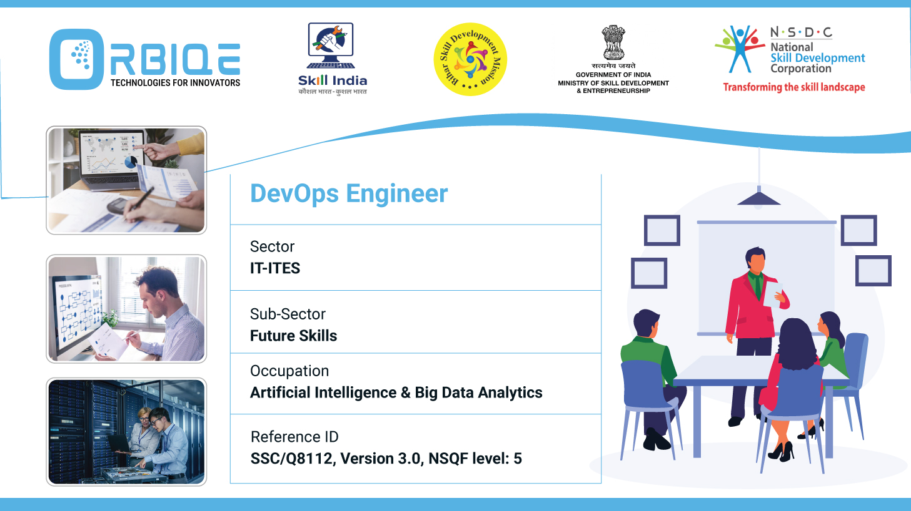
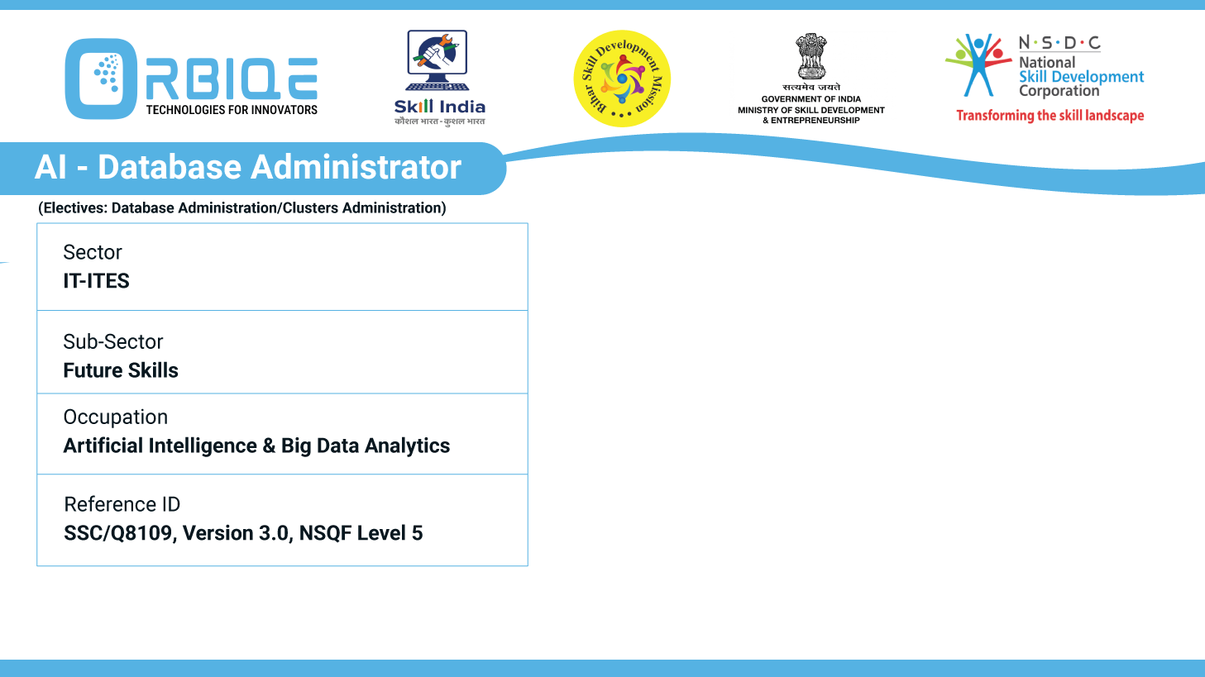
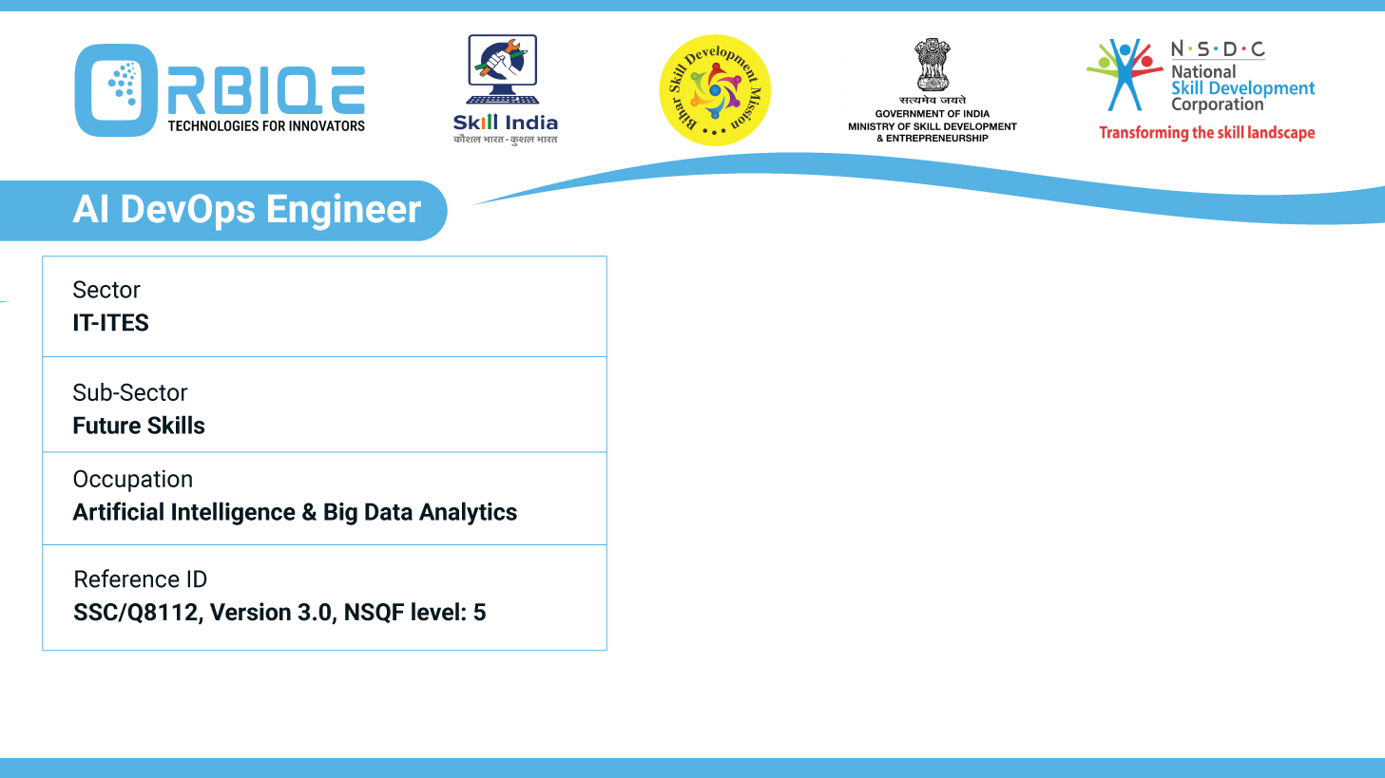
Name- Krishna Kant Dubey

Slide 2

Overview of Global Data Regulations and Standards

Slide 3
Agenda
Discuss the need for data regulations and standards
Analyze commonly used global data regulation policies (such as GDPR)
Discuss the roles and responsibilities of key actors involved in enforcing data regulations and standards
Organizations in the enforcement of data regulations and standards

Slide 4
Why Data Regulations and Standards Are Essential
Protecting Privacy and Personal Rights
Ensuring Transparency and Accountability
Maintaining Data Quality and Integrity
Facilitating Global Cooperation
Driving Innovation and Economic Growth

Slide 5
Organizations in the enforcement of data regulations and standards
European Data Protection Board (EDPB)
Jurisdiction: European Union
Focus: Enforces the General Data Protection Regulation (GDPR).
Role: Coordinates national data protection authorities, issues guidelines, and resolves cross-border disputes.

Slide 6
Organizations in the enforcement of data regulations and standards
U.S. Federal Trade Commission (FTC)
Jurisdiction: United States
Focus: Enforces consumer privacy laws including COPPA and aspects of CCPA.
Role: Investigates data breaches, deceptive data practices, and enforces penalties.

Slide 7
Organizations in the enforcement of data regulations and standards
UK Information Commissioner’s Office (ICO)
Jurisdiction: United Kingdom
Focus: Enforces the UK Data Protection Act 2018 and UK-GDPR.
Role: Provides guidance, investigates breaches, and issues fines

Slide 8
Analyze commonly used global data regulation policies (such as GDPR)
Key Features
Scope: Applies to any organization processing personal data of EU residents, regardless of location.
Core Principles: Lawfulness, fairness, transparency, Purpose limitation, Data minimization, Accuracy, Storage limitation, Integrity and confidentiality
Rights of Data Subjects:
Right to access, rectify, erase (right to be forgotten), Data portability
Right to object and restrict processing
Protection against automated decision-making

Slide 9
Discuss the roles and responsibilities of key actors involved in enforcing data regulations and standards
Chief Data Officer (CDO)
Role: Strategic leader for data governance.
Responsibilities:
Define and align data policies with business goals.
Oversee compliance with regulations like GDPR, HIPAA, etc.
Coordinate cross-functional governance initiatives.

Slide 10
Discuss the roles and responsibilities of key actors involved in enforcing data regulations and standards
Data Governance Council
Role: Cross-functional oversight body.
Responsibilities:
Approve data policies and frameworks.
Resolve governance disputes.
Ensure alignment with legal, IT, and business units

Slide 11
Discuss the roles and responsibilities of key actors involved in enforcing data regulations and standards
Compliance Officer / Legal Counsel
Role: Regulatory expert and risk manager.
Responsibilities:
Interpret laws like GDPR, CCPA, PIPL.
Advise on data-sharing agreements and breach protocols.
Liaise with regulators and handle legal disputes

Slide 12
Thank You

